Slide 1
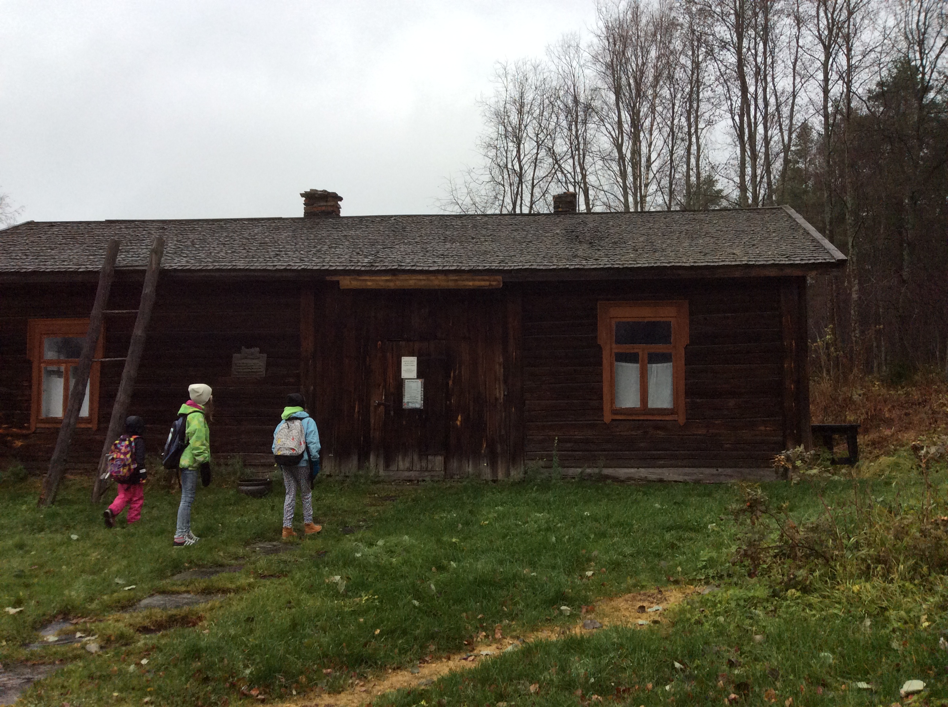
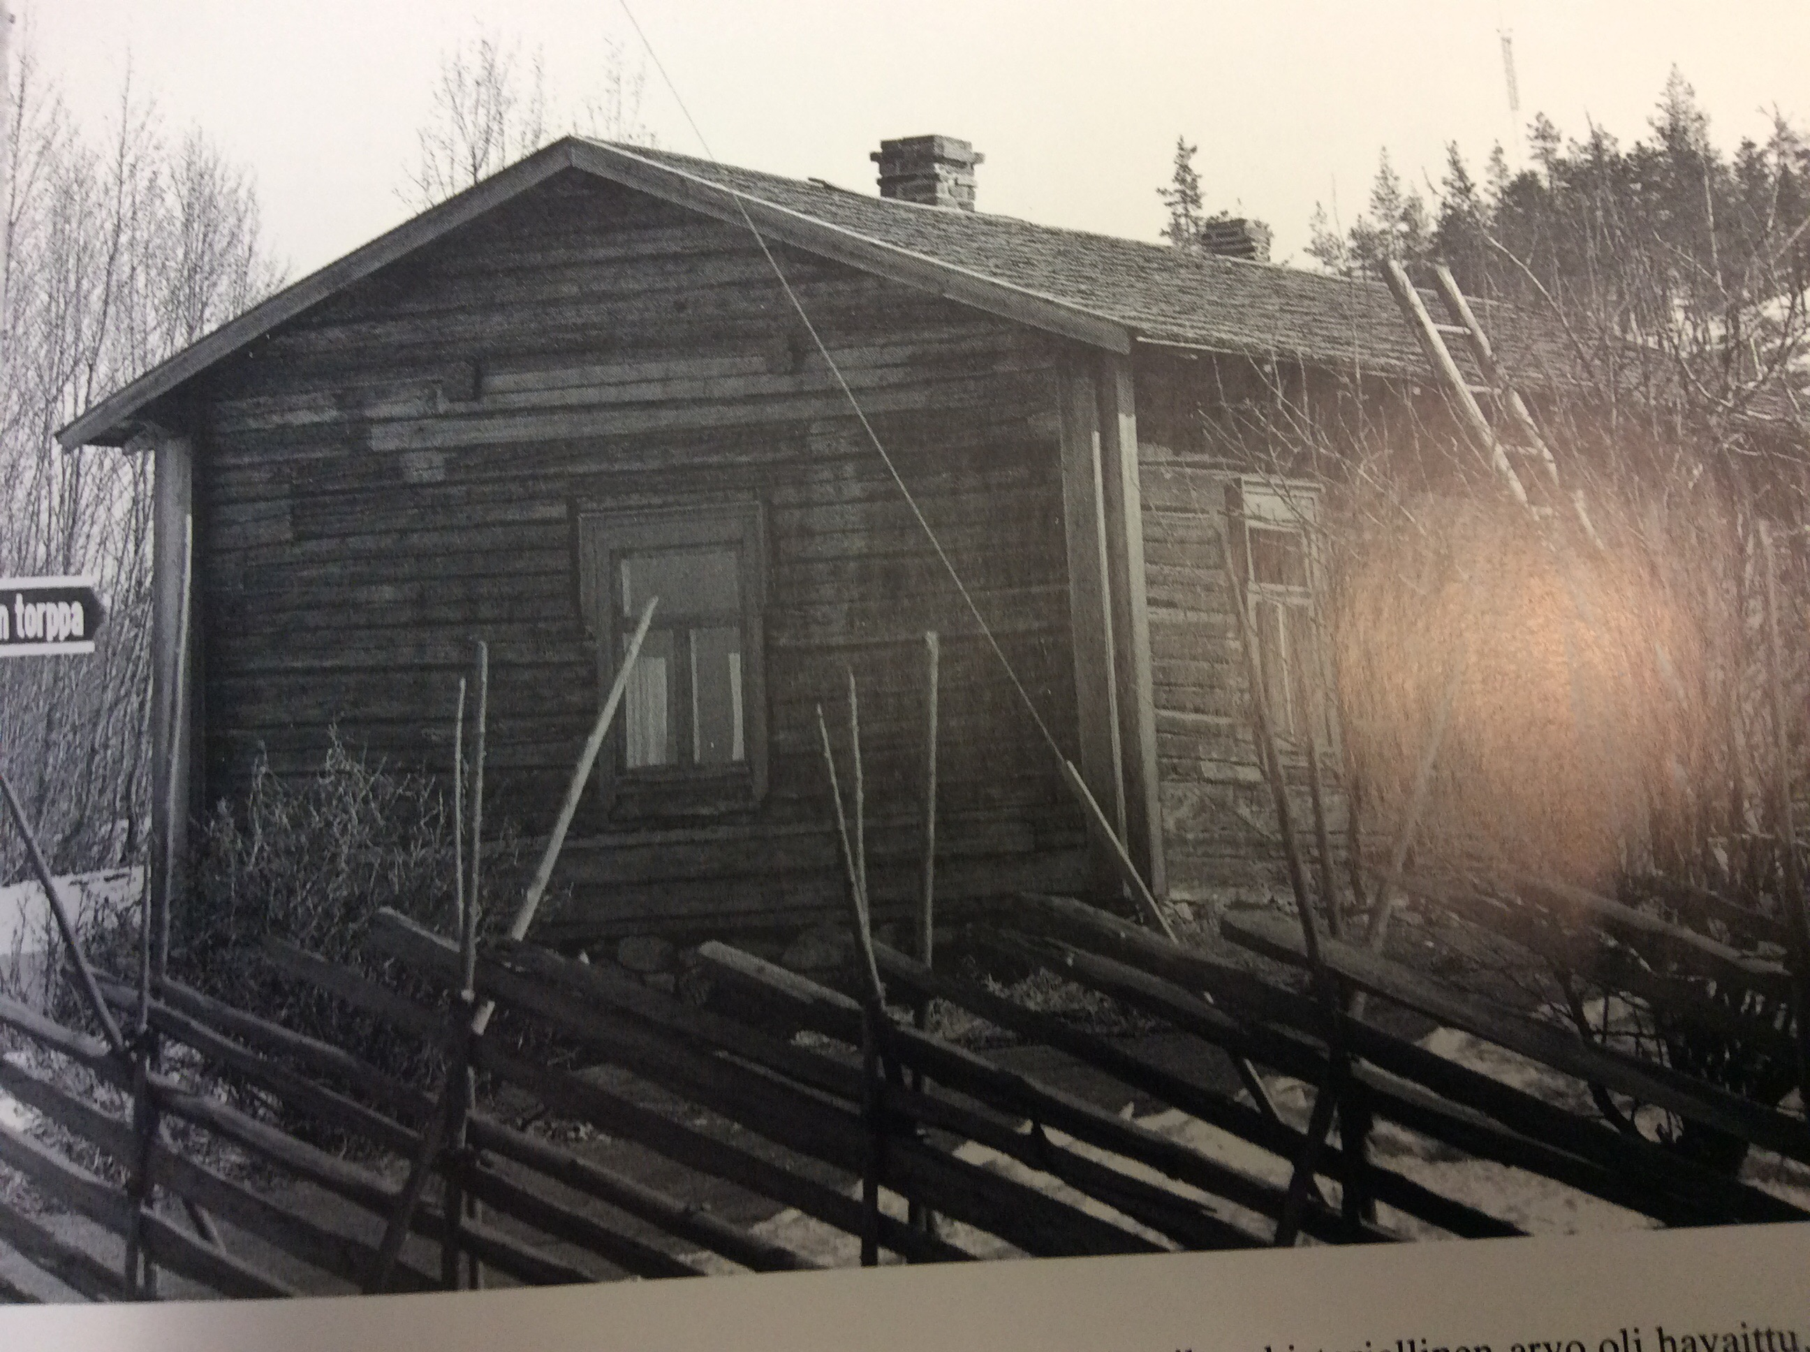
Lepikon torppa
Birthplace of Urho Kekkonen

Slide 2
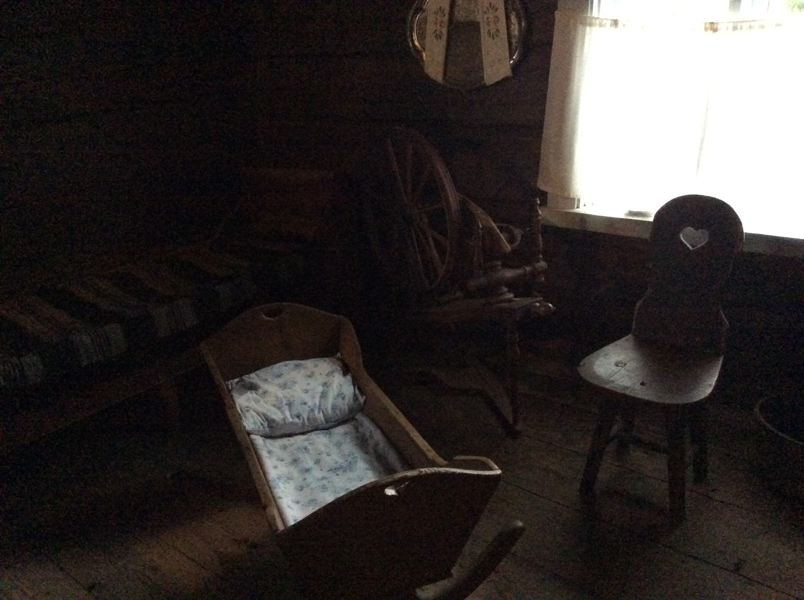
Interior pictures Forestry foremans tools hanging on the wall.
I

Slide 3
Lepikko's steps
The croft was established after the middle of the 19th century. It was built of logs in same style as smoke cottage (but the corners are later covered with boards).
Year 1864 it changed from a cottage to a croft.
The outfit of the house has changed couple of times.
It become a museum year 1966 and restored in the same outfit what it was when Kekkonen lived there.
Lepikon torppa Museum is one of the Finnis national cultural treasures.

Slide 4
Lepikko´s location
- In Pohjois-Savo
- In Pielavesi
https://www.google.fi/maps/place/72400+Lepikon+torppa/@63.2212076,26.7660021,14z/data=!3m1!4b1!4m2!3m1!1s0x4684875a3b168c03:0xfa1cbe346275e231

Slide 5
Urho´s family life in Lepikko
The family moved in Lepikko croft year 1900.
Urho Kekkonen was born in the same year.
Lepikko was the first own home of Kekkonens family.
They moved away when Urho was six years old.

